Slide 1

UMBC Cyber Defense Team
Web Exploitation 2
2016-2017

Slide 2

whoami
Josh
UMBC Alumnus
CyberDawgs Council of Elders (pending approval)
Cutlery Afficianado
Gun Nut
Hacker
Associate Security Analyst at Independent Security Evaluators (ISE)

Slide 3
Today’s Agenda
Recap
More covering of basics
Server-Side exploits
Misc.

Slide 4
HTTP
Primary protocol for communication over the web
Supports different request methods, with different properties
Stateless

Slide 5
Web Browsers
Primary method for users to communicate via HTTP
Supports many different technologies
HTML
CSS
Javascript
XML
AJAX
SOAP
Etc.

Slide 6
Recap
Proxies
Scanners (nikto, ZAP, nmap, etc.)
Attacks (SQL Injection, Directory Traversal, Insecure Direct Object Reference)

Slide 7
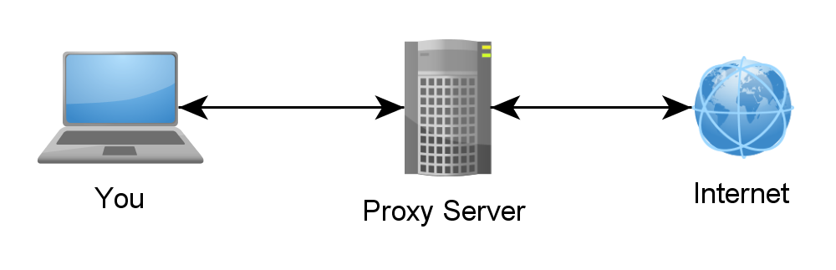
Internet Proxy (not exactly…)
https://4.bp.blogspot.com/-rxJLyRDjM1M/VzscbG8OquI/AAAAAAAAG-c/3JDSVbdo5SQfBwp0IMNJRIk9j5hYUFRogCLcB/s1600/proxylist%2B2016.png

Slide 8
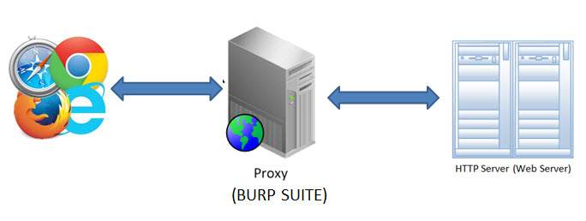
More Like This
https://www.tutorialspoint.com/security_testing/images/working_model_burp.jpg

Slide 9
More Recap

Slide 10
What is SQL?
Query language for databases (PostgreSQL, MySQL, MSSQL, etc)
Defines how data is retrieved and stored in a database.
Looks like this:
SELECT a, b FROM some_table WHERE c=”some_value”
SQL Slide Deck Stolen from TooManyBananas and Scyphor

Slide 11
What is an Injection?
It’s a needle that goes in your arm and gives you medicine, but that’s not important right now.
A SQL injection, on the other hand, is a way to trick an application and send it false data, or insert your own data.
This is because applications often insert user input directly into a SQL query without any pre-processing.

Slide 12
How do I do this?
First, let’s look at a typical SQL query that can be used to check if a user is allowed to log in.
SELECT * FROM users WHERE username=’user_input’ AND password=’user_input’
This will return a database row with the info about the user if and only if the user enters a username that exists, and enters the password that is stored in that database row.
Let’s break this query down into parts

Slide 13
Query
SELECT * FROM users WHERE username=’input’ AND password =’input’
Operation, Data, Table to get, and the constraint
Let’s say we know the username of a user but don’t know their password. How could we modify this query, modifying only the stuff inside the single quotes above?
In other words, we want to modify the logic of this query so that it will return the row we want no matter what.

Slide 14
- - # //
Luckily, we have a couple constructs that can help us with this. Namely, comments!
The SQL language supports comments, and if the application doesn’t sanitize our input we can use comments to inject our own code and modify what the query actually does.
We also need to handle the fact that our input is inside single quotes.

Slide 15
Inject!
So, we can enter the desired username in the username field, and in the password field (assuming passwords aren’t encrypted) we can enter the string ‘ OR 1=1 --
The final query will therefore be:
SELECT * FROM users WHERE username=’bob’ AND ‘’ OR 1=1 --’
The final quote will be removed since it is after the comment (--).
Since 1=1 is always true, the constraint will evaluate to:
username=’bob’ AND ‘’ OR

Slide 16
Reducing Logic
Since 1=1 is always true, the constraint will evaluate to:
username=’bob’ AND ‘’ OR true
This becomes:
username=’bob’ AND true
Which becomes
username=’bob’
Bingo! We’ve successfully reduced the constraint to only depend on the username.

Slide 17
Misc
It very rarely will be this easy. First of all, the comment syntax differs based on the product being used (--, #, and // are all comment forms for different DB products).
Second, oftentimes your input will be sanitized, and you will have to beat that filter somehow. Experimentation is key here.

Slide 18
How do you resolve this?
Validate user input via parameterized queries

Slide 19
Example
String query = "SELECT * FROM accts WHERE account = ?";
PreparedStatement pstmt = connection.prepareStatement(query , … );
pstmt.setString( 1, request.getParameter("acct"));
ResultSet results = pstmt.executeQuery( );
http://example.com/app/accountInfo?acct=notmyacct

Slide 20
Insecure Direct Object Reference
Exposing a reference to an internal implementation object
Files, directory, etc.
Directory Traversal
No access control/check
Allows access to unauthorized data

Slide 21
How fix?
Implement functioning access controls
If application roles - RBAC

Slide 22
Directory Traversal
Form of Insecure Direct Object Reference
Accessing arbitrary files

Slide 23
How fix?
Canonicalize paths to files
Resolve elements like “..”, “../”, etc.
Access Control - Validate these paths
Should the user be able to access this file?

Slide 24
Local File Inclusion
Upload/overwriting system files
Many use cases

Slide 25
How fix?
Validate user input (filenames and paths)

Slide 26
Command Injection
Gain the ability to execute arbitrary system commands on the web server
Caused by inadequate parsing of user-supplied data to the web app

Slide 27
How fix?
Don’t call shell commands if possible (use the API instead)
Ex. Python
os.system(‘id’) vs os.getuid()
If not possible, sanitize input
Only allow expected input (e.g. escaping special characters, rejecting bad input, etc.)

